Slide 1
Simulated Motion Planning of Mobile Robot- Pioneer 3-DX
Spring 2024
ME596: Independent study
Student: Saurabh Ramesh Bharane
UIN: 669 485 920
Guided by: Professor Pranav Bhounsule

Slide 2
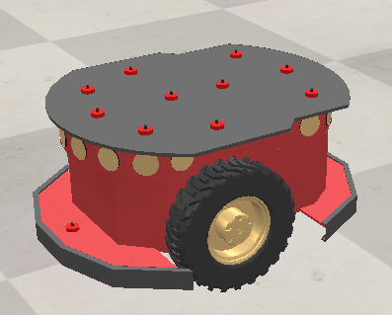
Introduction
Elements of autonomous motion planning
Path planning
Decision making
Map Representation
Safety and collision avoidance
Localization
Motion control
Perception
Trajectory generation

Slide 3

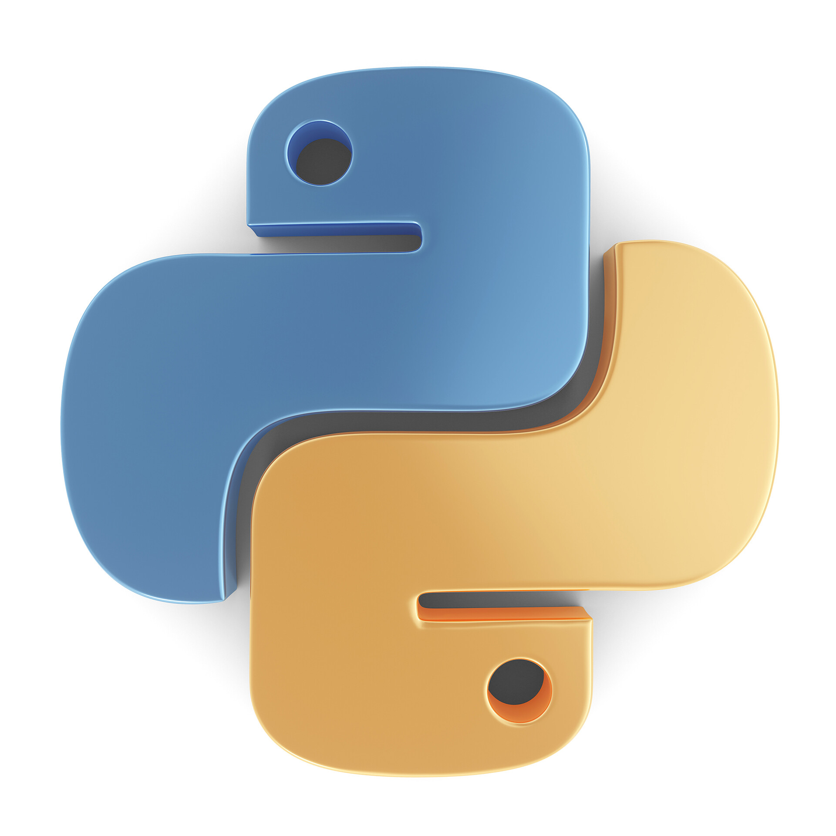

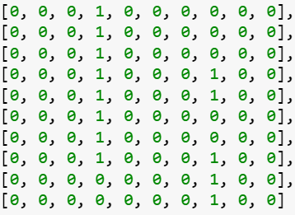
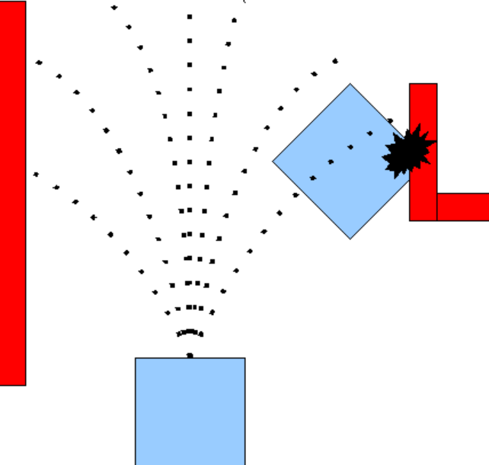
Introduction - Elements of the project
CoppeliaSim
Python
A Star
Occupancy Grid
Dynamic Window Approach
Simulator for executing the simulation of the Pioneer 3-DX
Coding Language
Path planning Algorithm
(Global path planning)
Environment representation using the occupancy Grid
Local Path Planning
Pioneer 3-DX
Mobile Robot

Slide 4
Introduction – Overview of work
This presentation gives information of the work done in the project.
It includes step-by-step explanation to execute and modify the project.
The following modules have been explained in the subsequent slides.
Initial setup of CoppeliaSim and python
Execute the project using python script.
Environment setup
A Star global planner overview and code explanation
Localization commands
Trajectory generation
Motion control
DWA Local planner
Computer vision
Future work

Slide 5
Initial Setup
I have provided following folders with the package.
CoppeliaSim setup guidance
Project work
Individual module development.
Google Drive link for complete Project is provided at the last Slide.

Slide 6
Initial Setup
Download latest version of the CoppeliaSim and the Python.
Enable Python in the CoppeliaSim by providing the python path. Follow instructions in the file “setting_python_path” provided in the folder “CoppeliaSim_setup_guidance”. This needs to be done once per system.
I have provided Step 4 files in the project work so; you can skip that step and move on to the next slide. If you want information for the initial setup, you can look at Step 4.
To control CoppeliaSim externally using python, use remote API Bindings provided by the CoppeliaSim. Use “CoppeliaSim Remote API binding.pdf” provided in folder “CoppeliaSim_setup_guidance\Set_Coppelia_External_Python Basics_Pioneer_Control” for setup details. This task must be completed for each new project. Mentioned PDF gives names and location of files to be copied in the project folder.

Slide 7
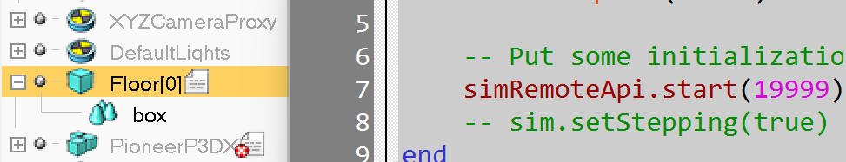
Execution of the Project
Running the project file
Open CoppeliaSim and open scene “Scene_Motion_planning_P3DX” provided in folder “Project work\Motion Planning Execution”.
Python connection command “simRemoteApi.start(19999)” is added in the “Floor” script.
PioneerP3DX default script is disabled.
Open “Command prompt” or “Spyder” for code execution.
Scene “Scene_Motion_planning_P3DX.ttt”, Code “Code_Motion_planning_P3DX.py” and Python API bindings for Windows OS and MacOS are copied in the folder “Project work\Motion Planning Execution”. For details refer slide 3 - point 4.
Run the code “Motion_planning_P3DX.py” from folder “Project work”

Slide 8
Execution of the Project
Running the project file
Run scene “Scene_Motion_planning_P3DX”.
Run the Code “Code_Motion_planning_P3DX.py” using Spyder or Command Prompt.
Use following command to run code using command prompt
python <replace with path>\ Motion Planning Execution \ Code_Motion_planning_P3DX.py
This will start executing the motion planning algorithm and Pioneer 3DX will start moving to reach the goal based on optimized path.

Slide 9
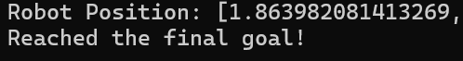
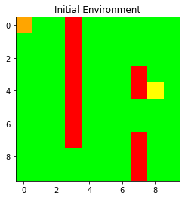
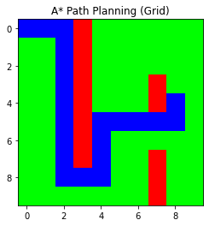
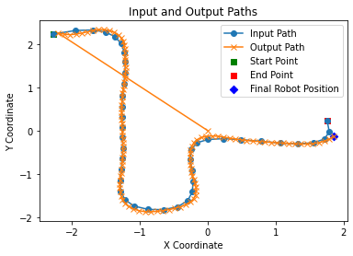
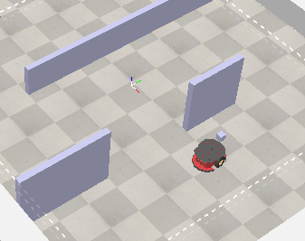
Execution of the Project
Output of the execution of code
Based on Spyder or Command prompt. The code will generate following filles and output.
Optimal Path (Grid) and Optimal Path (World Coordinates) to be followed by the Pioneer 3DX.
Images for Map, Optimized path avoiding the obstacles and Path followed by the Pioneer 3DX.
It will also generate the live co-ordinates of the Pioneer 3DX.
At the end it will provide message “Reached the final goal!”.

Slide 10
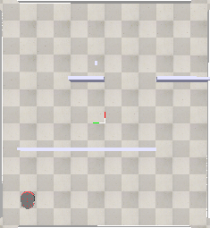
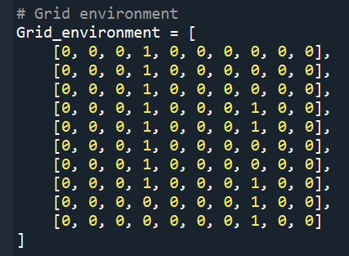
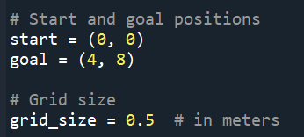
Motion planning code and algorithm explanation
Grid and Environment setup.
Code “Code_Motion_planning_P3DX.py” is explained in this slide and in further slides. It is provided in the folder “Motion Planning Execution”
Each block on floor is 0.5m x 0.5 m.
Bocks with obstacles are represented by “1” and free space is represented by “0” in python code.
Change position of “1” and “0” to modify the obstacle position.
Change size of environment by changing Grid environment size and CoppeliaSim environment size.
Change obstacles as needed.
Change Start and Goal Position co-ordinates to modify start and goal.
Provide start coordinates equal to the initial position of Pioneer P3DX.
Obstacle
Start
Goal
Y
Origin
X
CoppeliaSim
(Environment)
Representation of Environment in Python

Slide 11
Motion planning code and algorithm explanation
Start and Goal setting.
Pioneer 3DX is at Zeroth column and Zeroth row of the Grid_environment. So, start is (0, 0).
Goal is at 4th row and 8th column so, Goal is (4, 8). Measure the row number and column number to set the start and goal. Set the axis of CoppeliaSim as shown in figure for correct orientation.
Start
Row = 0th
Column = 0th
Start
Goal
Goal
Y
Origin
Row = 4th
Column = 8th
X
CoppeliaSim
(Environment)
Representation of Environment in Python

Slide 12
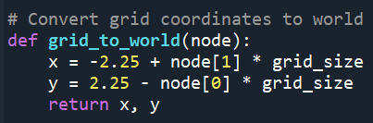
Motion planning code and algorithm explanation
Grid and Environment setup.
The first block in the grid has coordinates (- 2.25, 2.25).
Modify “grid_to_world” function whenever environment size changes. Put coordinates of the first block at “x” and “y” variables
This function assigns world coordinates to the grids of “1” and “0”.
First Block of Grid
Y = 2.25 m
X = -2.25 m
Origin
CoppeliaSim
(Environment)

Slide 13
Motion planning code and algorithm explanation
A-star search Algorithm.
The A-star algorithm is searching algorithm used to find the shortest path between a start and the goal.
It is optimal algorithm, as it searches for shorter path. It finds the least cost outcome for the problem.
Important aspect of A* is f = g + h
f is the total cost of the node and g is the distance between the current node and the start node. h is the heuristic - estimated distance from the current node to the end node.
f value for all the neighboring nodes is calculated and the node with minimum total cost is selected.
Set of such minimum cost nodes make the optimal path in the A-Star Search.
Goal
Current node
Environment

Slide 14
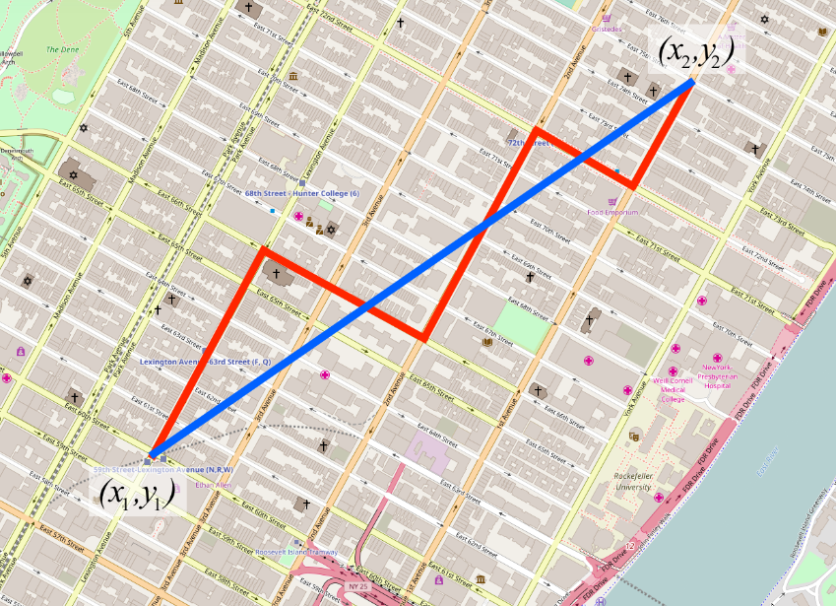
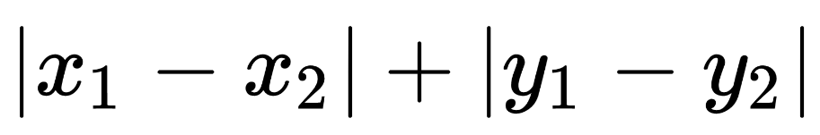
Motion planning code and algorithm explanation
A-star search Algorithm.
Calculation of the heuristics – Two methods Exact and approximate. For current problem, Manhattan Distance, the approximate heuristics is selected to estimate distance from current node to goal node. As we have obstacles in the path. It is calculated by following formula.
Manhattan distance, also known as taxicab distance or city block distance, is a measure of the distance between two points in a grid-based environment. It is calculated by following formula.
This heuristics can be used when we can move in 4 directions- Up, Down, Left, Right.
Euclidean Distance
Manhattan Distance

Slide 15
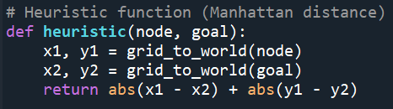
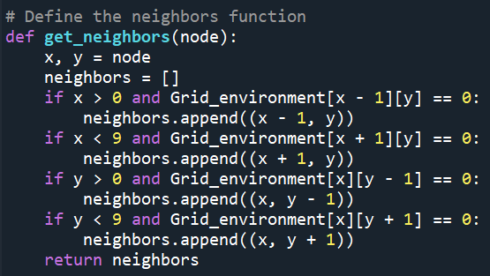
Motion planning code and algorithm explanation
A-star search Code.
Heuristic calculation code (Manhattan distance)
Successor node generation

Slide 16
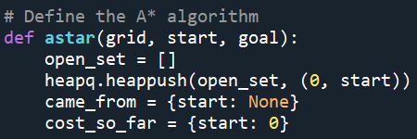
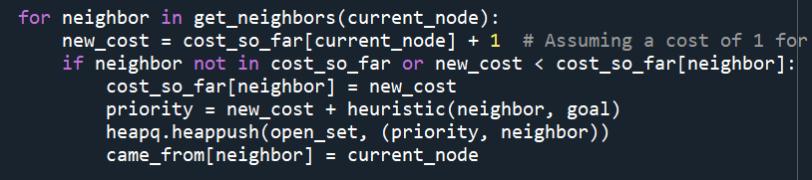
Motion planning code and algorithm explanation
A-star search Code.
A-Star function starts with these lines. This function can be replaced by another search algorithm as per requirement.
The f cost, g cost ang h cost is given by these lines.
f = g + h

Slide 17
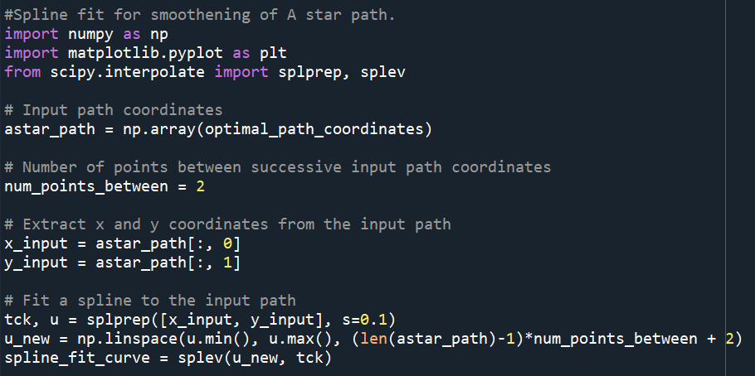
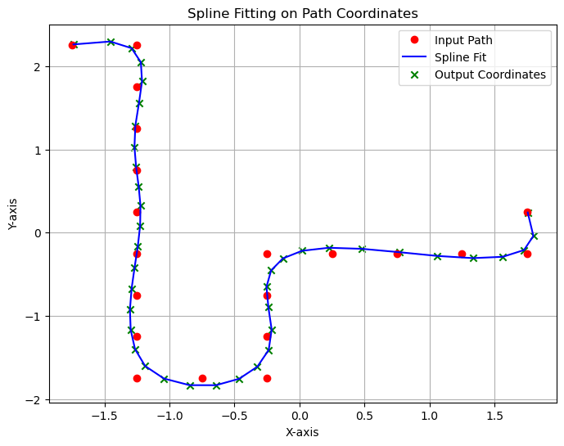
Motion planning code and algorithm explanation
Spline fit for smoothening of A star path.
The path obtained by the A-star search have sharp curves, it is made rounder for smoother turns using spline fit. Change “num_points_between” and “s” to change degree of curvature. Red dots in the image are coordinates given by the A-star search and blue line is spline fit.

Slide 18
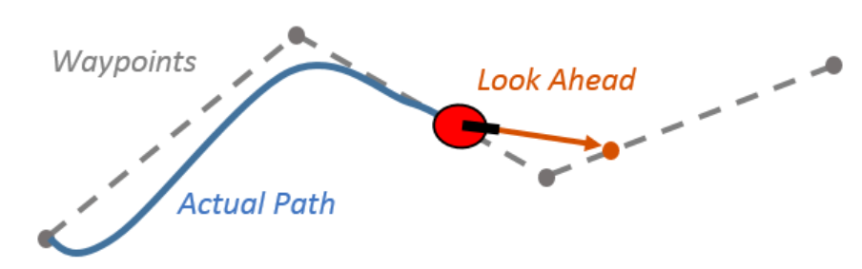
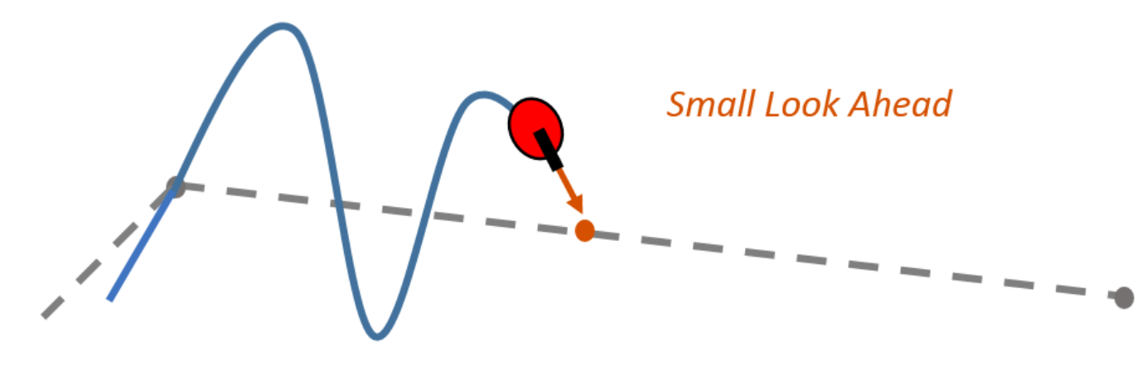
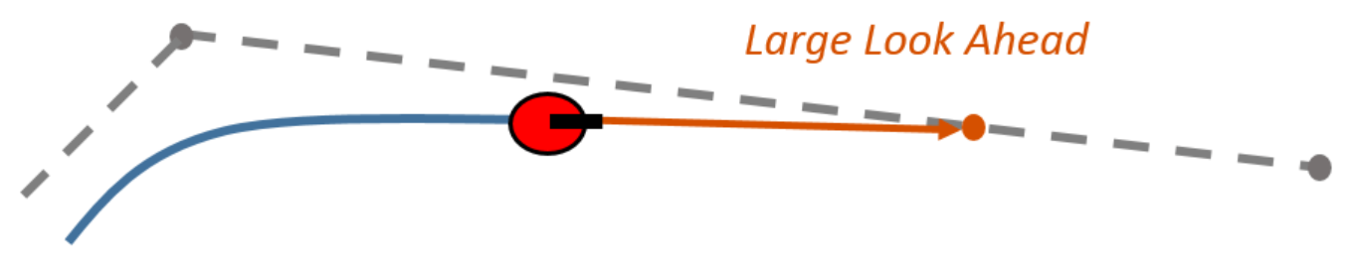
Motion planning code and algorithm explanation
Pioneer 3-DX movement using “Pure Pursuit” algorithm.
Pioneer 3-DX moves on the A-star search and spline fit curve using the “Pure pursuit” algorithm .
“Pure pursuit” is designed to allow a vehicle to follow a desired path by continuously adjusting its steering angle based on the current state and the path geometry.
Path Representation: Desired path represented as waypoints or smooth curve. These points are the output given by the spline fit.
Lookahead Distance: Defines how far ahead vehicle looks along desired path, influencing steering adjustments.
Finding the Target Point: Vehicle calculates target point based on current position and orientation.
Steering Angle Calculation: Calculate steering angle to move towards target point.
Control Action: Vehicle adjusts steering angle to move towards target point.
Iterative Process: Continuously repeat process as vehicle moves along path.

Slide 19
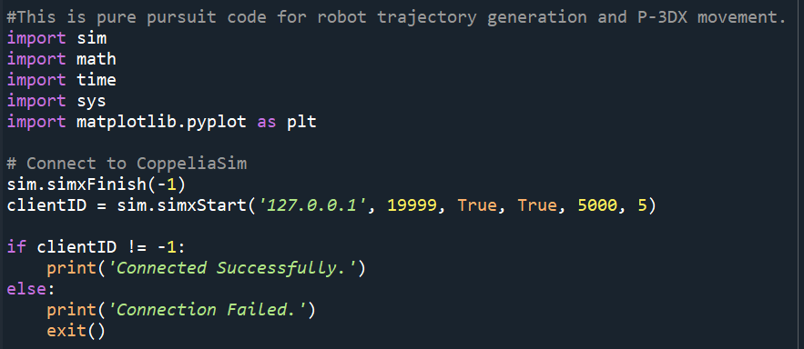
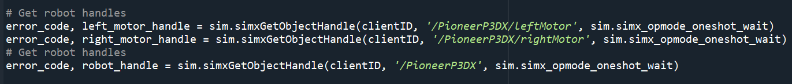
Motion planning code and algorithm explanation
Pioneer 3-DX movement using pure “Pure Pursuit” code explanation.
Following code establishes connection between CoppeliaSim and Python to execute A-star, spline fit on Pioneer 3-DX using pure pursuit.
This code obtains robot handles and motor handles from the CoppeliaSim for execution of python code.

Slide 20
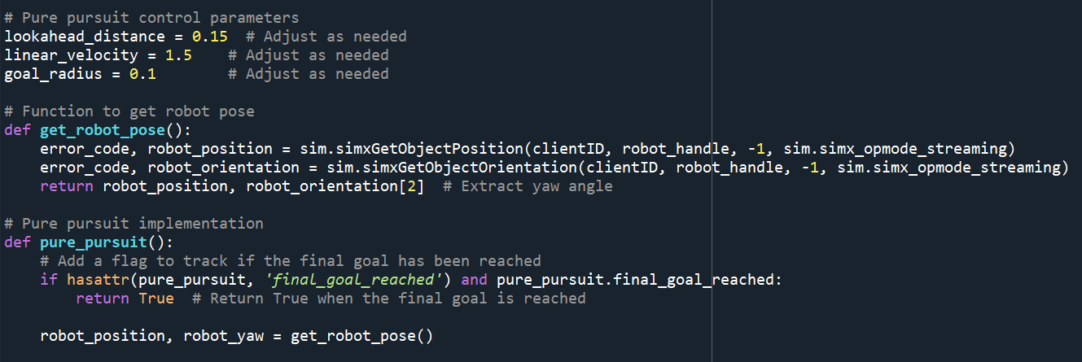
Motion planning code and algorithm explanation
Pioneer 3-DX movement using pure “Pure Pursuit” code explanation.
“get_robot_pose” Function obtains real time coordinates of the robot from the CoppeliaSim.
“pure_pursuit” function executes the “Pure pursuit” based on A-star search, spline fit, robot and motor handles and robot's current position.
Change ”lookahead_distance”, “linear_velocity” and “goal radius” to modify path curvature, velocity and goal radius (code execution completes when robot reaches in that radius from the goal).
Further code is added to plot the output graphs and images. This completes the code “Code_Motion_planning_P3DX.py”

Slide 21
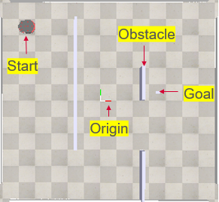
Motion planning code and algorithm explanation
Code- “Code_Motion_planning_P3DX.py” and Motion planning through the graphics.
Grid Representation
(Python)
Grid in Image form
(Python)
A-star path
(Python)
CoppeliaSim Environment
Spline-Fit
Pure pursuit execution
(P 3-DX movement)

Slide 22
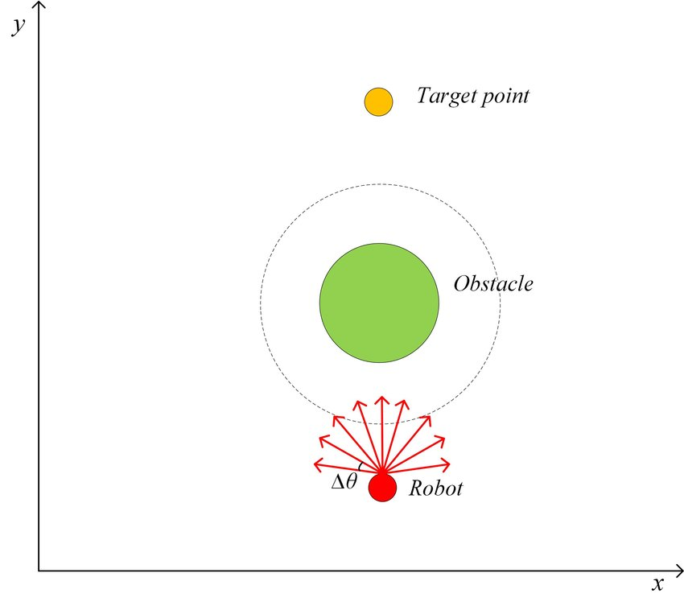
DWA Local planner development
DWA (Dynamic Window Approach)
"Dynamic Window Approach." It's a motion planning algorithm commonly used in robotics, particularly for mobile robot navigation and obstacle avoidance. DWA is especially popular in scenarios where robots need to navigate in dynamic environments, reacting to changes in real-time.
Velocity Sampling: DWA operates by sampling a range of velocities for the robot within a predefined range of linear and angular velocities. This range is called the “Dynamic window.“
Collision Prediction: For each sampled velocity, DWA predicts the future position of the robot based on its current state and the selected velocity.
Trajectory Evaluation: DWA evaluates each sampled velocity by considering two main criteria: closeness to the goal and proximity to obstacles.
Velocity Selection: After evaluating all sampled velocities, DWA selects the velocity associated with the highest-scoring trajectory as the desired velocity for the robot.

Slide 23
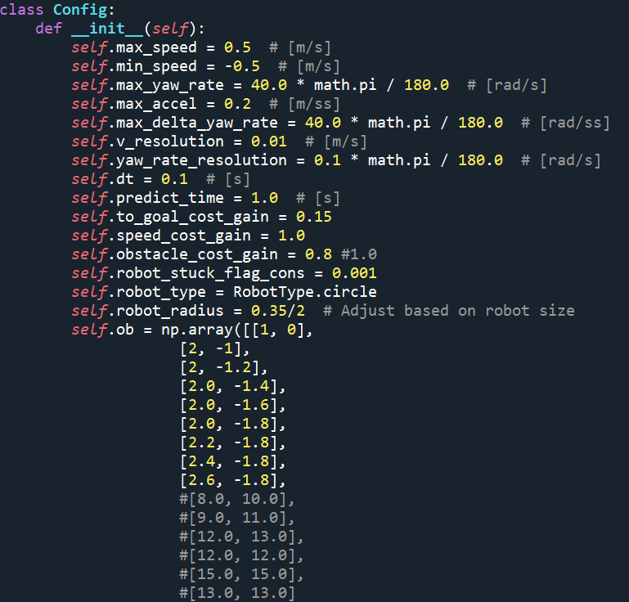
DWA Local planner development
DWA Code explanation.
Code “DWA_code.py” and scene “DWA_floor_scene” provided in the “DWA” folder.
Run the Scene in CoppeliaSim and then run the code using “Spyder” or “Command Prompt”.
Code related to Motor handles and python- CoppeliaSim is explained previously.
Modify the DWA parameters in the __init__ function to get the optimum results. Speed_cost_gain, to_goal_cost_gain and obstacle_cost_gain are important parameters to calculate the optimum results based on requirements. The further code is developed to define these cost functions and combine them as DWA implementation.
Modify obstacle location coordinates in self.ob

Slide 24
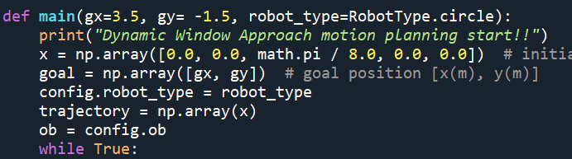
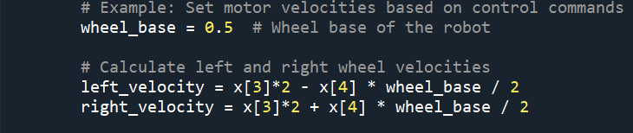
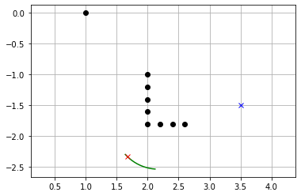
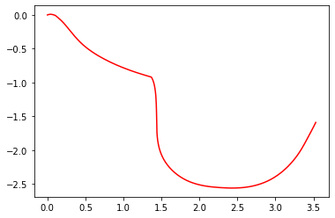
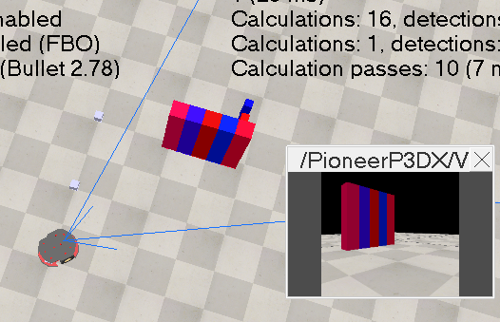
DWA Local planner development
DWA Code explanation.
Modify “gx” and “gy” to change the location of the goal coordinates. Modify “wheel_base” according to robot size.
Output includes DWA generated path.
Real time image is generated to show the DWA implementation in python window. It completes the “DWA_code.py”.
Real time image
Path traversed
CoppeliaSim Window

Slide 25
Future Scope
DWA can be implemented using the computer vision.
Integration of DWA local planner with the A-star global planner.
Implementing the simulation with new simulator.
Implementing the Motion planning on Hardware.

Slide 26
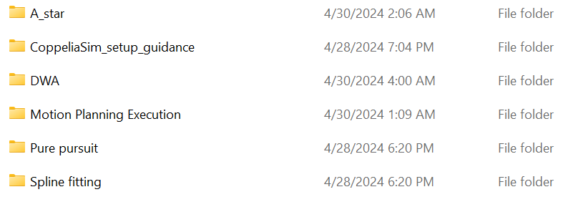
Supplementary Material
The complete code and scene of Motion planning and DWA is provided with required API bindings in “Project work” folder and following sub folders.
The individual development codes for A-star, spline fit, and pure pursuit is provided in the respective folders. CoppeliaSim setup guidance is provided in respective folder and explained in the earlier slides.

Slide 27
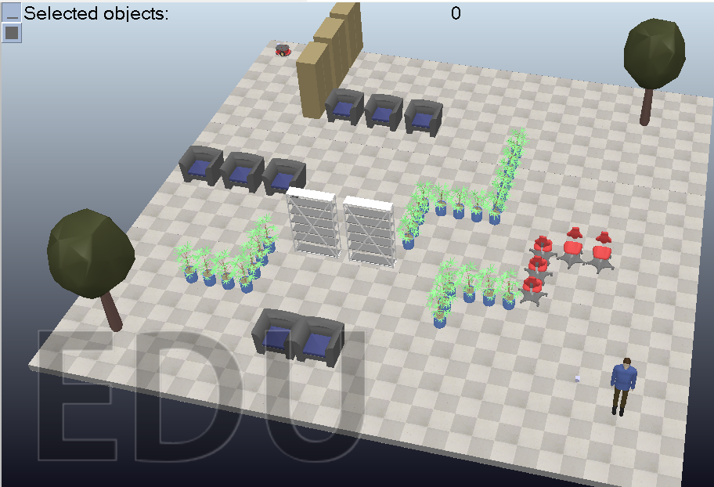
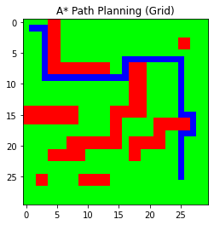
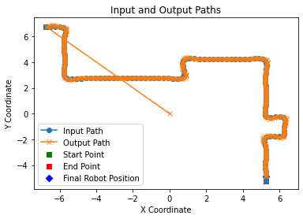
Supplementary Material
Implementation of Motion planning on the bigger environment is provided in the “Motion Planning Execution” folder with code “Code_Motion_planning_P3DX_version_2.py” and scene “Scene_Motion_planning_P3DX_version_2”

Slide 28
Google Drive link for the “Project work” folder
Download “Project work” folder from the following Google Drive link. It is accessible to anyone with the link.
https://drive.google.com/drive/folders/1l3ni4km1TrvQbEWUJoVjoCS8c8aAXtpc?usp=sharing
YouTube Link for the working model of Motion planning on P-3DX.
P 3DX version 2 Video- https://youtu.be/2yMcM8VPj3c
P 3DX version 1 Video- https://youtu.be/OjDhxGP9NaU
DWA CoppeliaSim Python demo (Dynamic window Approach)- https://youtu.be/P98ZjHzeOtQ

